Slide 1
Maha-Nagar Online Home Services System (MOHSS)
Project Presentation
Submitted by:
Jay Shyam Patel
BCA 4th Semester
Submitted to:
BCA Department
Kathmandu BernHardt College
Bafal, Kathmandu
1

Slide 2
Table of Contents
Introduction
Problem Statement
Objectives
Scope & Limitations
Methodology
Feasibility Study
Architecture Design
Process Modelling (Data Flow Diagram)
Data Modelling(ER-Diagram)
Database Schema Diagram
Use Case Diagram
Outcome (UI Design)
References

Slide 3
introduction
MahaNagar Online Home Services System (MOHSS) is the web portal for every home maintenance and services at the door step just by one click.
Several aspects like painting, pest control, home cleaning, plumbing, electrical works and carpentry services are involved in a system to provide happy and healthy home atmosphere in order to satisfy consumers.
Our online system for household services provides the most expedient and annoys free way to get your domestic work done.
We aim to help in providing optimal solutions to all your household troubles with more efficiency, ease and majorly, a delicate touch.
The primary objective of the online system for household services is about delivering the home services at the door step just by one click.
Notes:
This Proposal discusses about main theme of the online home services, numerous services provided and how the ordering and delivery of services takes place.
Online system for household services can be used by any authorized user intending to seek for household services through an ingenious web based system or a mobile application.
To provide an authenticated and authorized login module for the users such as service seekers, service providers and the admin, by providing appropriate credentials at the time of registration.
To develop a web based online system for opting household services and to develop an identical mobile application for opting the services.
To design an interactive User Interface for seeking services on the go. To provide a secured online payment gateway for service seekers.
To acknowledge the conformation of services opted by the users.

Slide 4
Problem statement
Since Household maintenance is daily required services in various household and their day-to-day routines so we chose to work on this project.
When someone need help with small or big household tasks, the problem arises when service skilled persons are unavailable or the trusted providers are impossible to find, who delivers consistently flawless service on instance.
There are very few existing system which offers very limited range of services.
Notes:
MOHSS is a leading multiple service provider catering to your 360 service needs with quality guaranteed.
With MOHSS web portal you can book your desired home service like electrician, plumber, carpenter, cleaner, painter, AC repair, Washing machine repair, and so many other services which serve directly to your door step in your desired timeslot and on affordable prices.
In this way MOHSS makes your life easy and full of comfort and we strive to serve all the maintenance requirements of customers and be a platform as a one stop solution for maintenance work

Slide 5
objectives
The objective of MahaNagar Online Home Services System (MOHSS) are:
To provide an authenticated and authorized login module for the users such as
service seekers, service providers and the admin, by providing appropriate credentials
at the time of registration.
To develop a web based online system for opting household services.
To design an interactive User Interface for seeking services on the go.
To acknowledge the conformation of services opted by the users.
Notes:
MOHSS is a leading multiple service provider catering to your 360 service needs with quality guaranteed.
With MOHSS web portal you can book your desired home service like electrician, plumber, carpenter, cleaner, painter, AC repair, Washing machine repair, and so many other services which serve directly to your door step in your desired timeslot and on affordable prices.
In this way MOHSS makes your life easy and full of comfort and we strive to serve all the maintenance requirements of customers and be a platform as a one stop solution for maintenance work

Slide 6
scope
The proposed software product is the MahaNagar Online Home Services System (MOHSS).
The intention of the system is to reduce burden in finding in-house solutions for the services, the proposed system provides several services by providing service specialists at your doorstep in one click.
A systematic web environment to system clients offers ease in accessing our
services in a more comfortable way.
With well qualified and background demonstrated professionals we make all your home cleaning, plumbing, furniture maintenance, electrical works, appliance repair, house painting, vehicle service and many other services to be done in a click
anytime from anywhere as easy as available.

Slide 7
limitations
Some Limitations of this system are:
No payments system is integrated yet.
There is no android app and iOS apps.
The system can be prolonged by adding many services such as catering services and many more.

Slide 8
Methodology
Requirement Identification
Study of Existing System
UrbanClap or Urban Company
Quickgo
SeWahh.com
SajiloSewa
Requirment Collection
Functional Requirement (Admin, Customer and Service Provider Interfaces)
Non Finctional Requirement (Performance, Safety and Security Requirements)

Slide 9
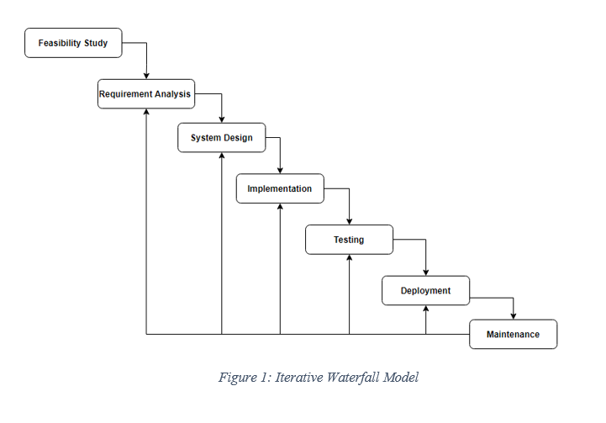
Methodology
Iterative Waterfall Model
We have used Iterative and Incremental Development model (IID) for our project development.

Slide 10
Feasibility study
Feasibility Study
Technical Feasibility
This system is technically feasible to develop since the technology required to develop the system is adequate and available.
Operational Feasibility
This system is operationally feasible as well since it would meet its objective.
Economic Feasibility
This system is economically feasible as the most of the resource used in this system will be open-source.

Slide 11
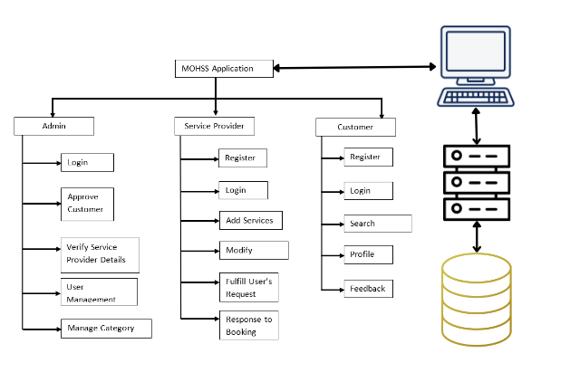
Architecture design
User Interface
Web
server
Database

Slide 12
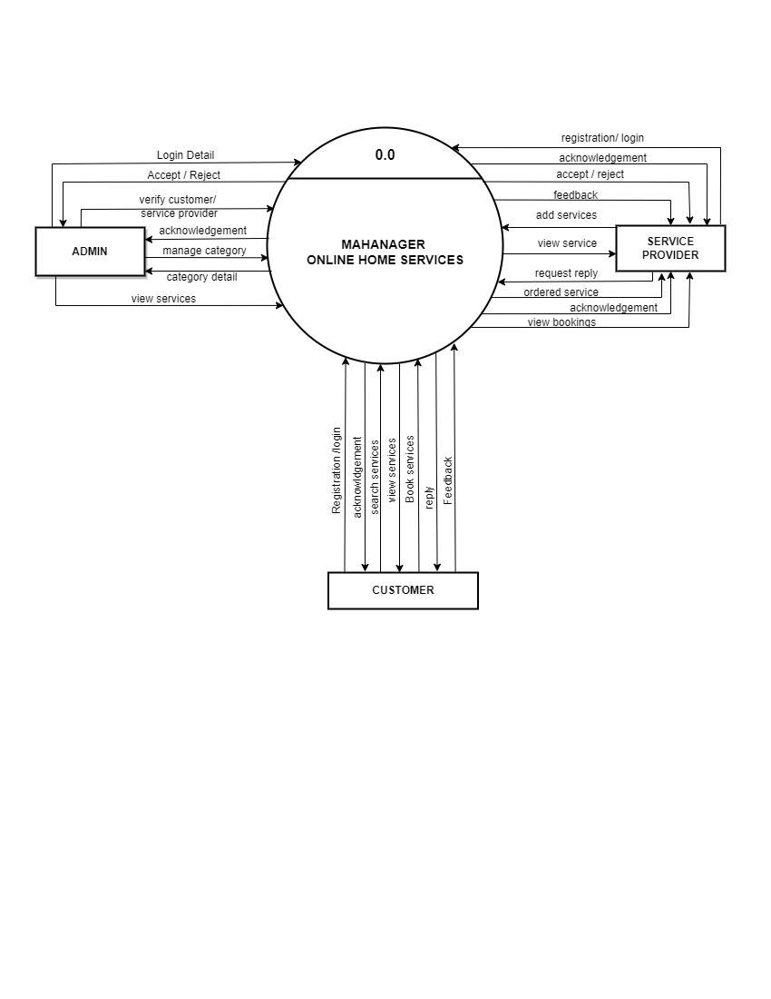
PROCESS MODELLING (Data flow diagram)
Figure : Level 0 DFD of MahaNagar Online Home Service System

Slide 13
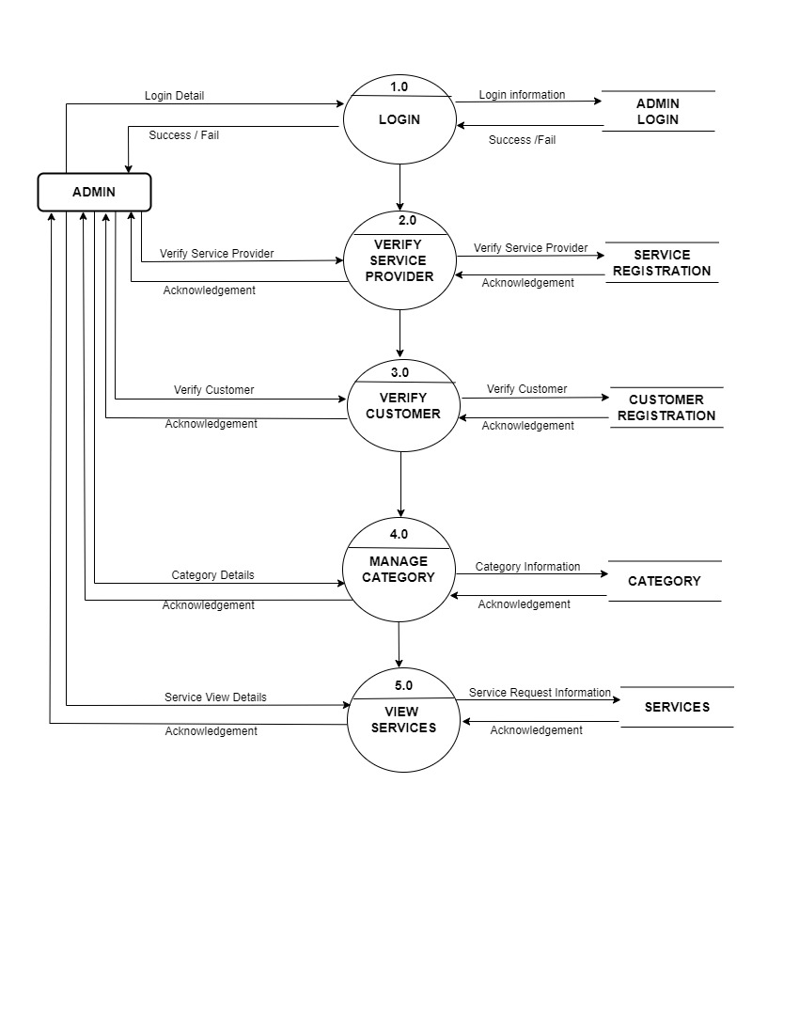
PROCESS MODELLING (Data flow diagram)
Figure : Level 1 DFD of Admin in MahaNagar Online Home Service System

Slide 14
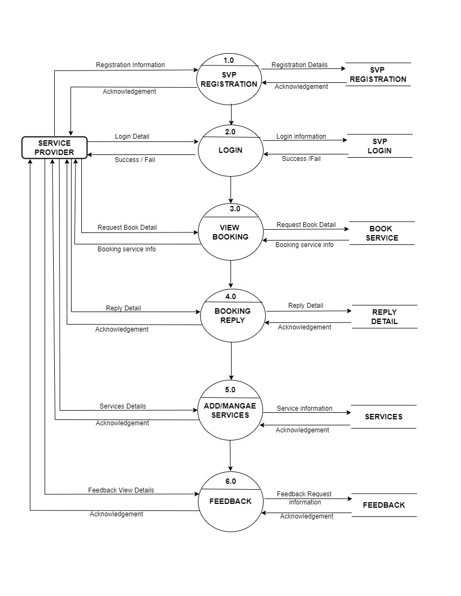
PROCESS MODELLING (Data flow diagram)
Figure : Level 1 DFD of Service Provider in MahaNagar Online Home Service System

Slide 15
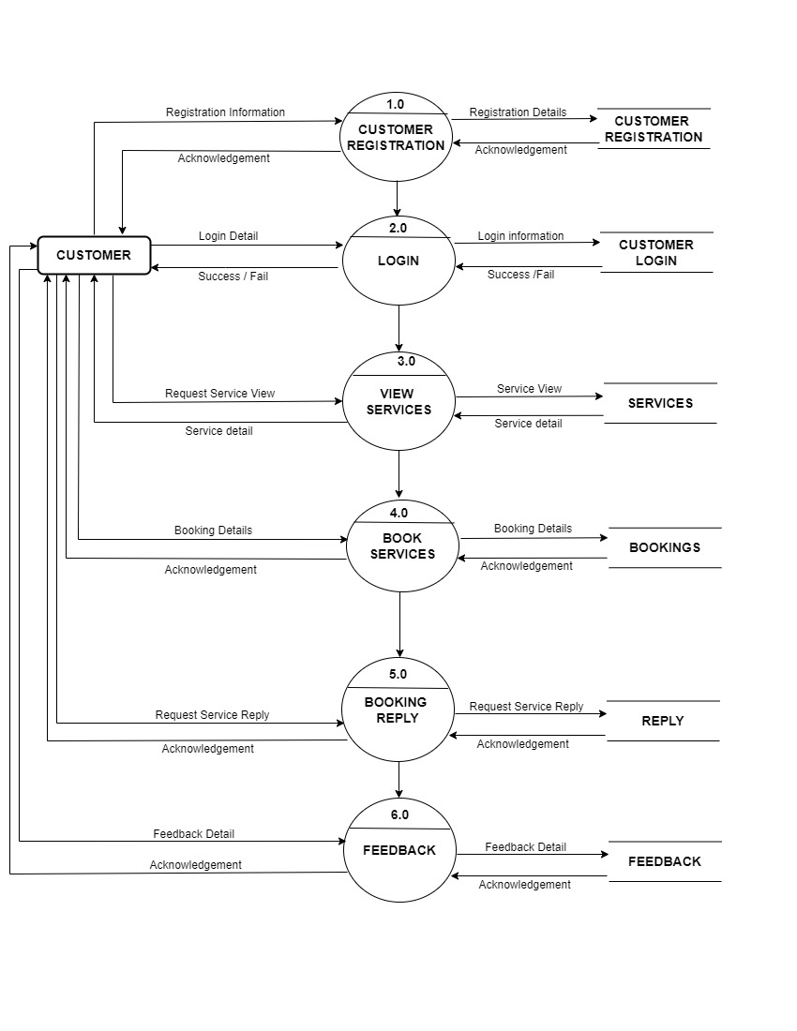
PROCESS MODELLING (Data flow diagram)
Figure : Level 1 DFD of Customer in MahaNagar Online Home Service System

Slide 16
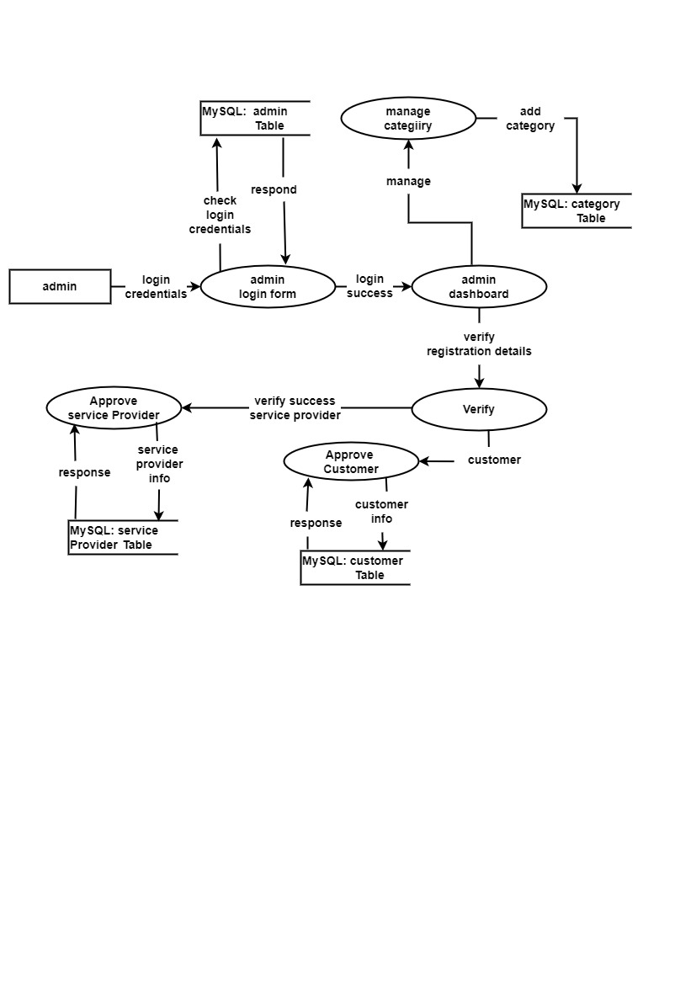
PHYSICAL DATA FLOW diagram
Figure : Physical DFD of MahaNagar Online Home Service System

Slide 17
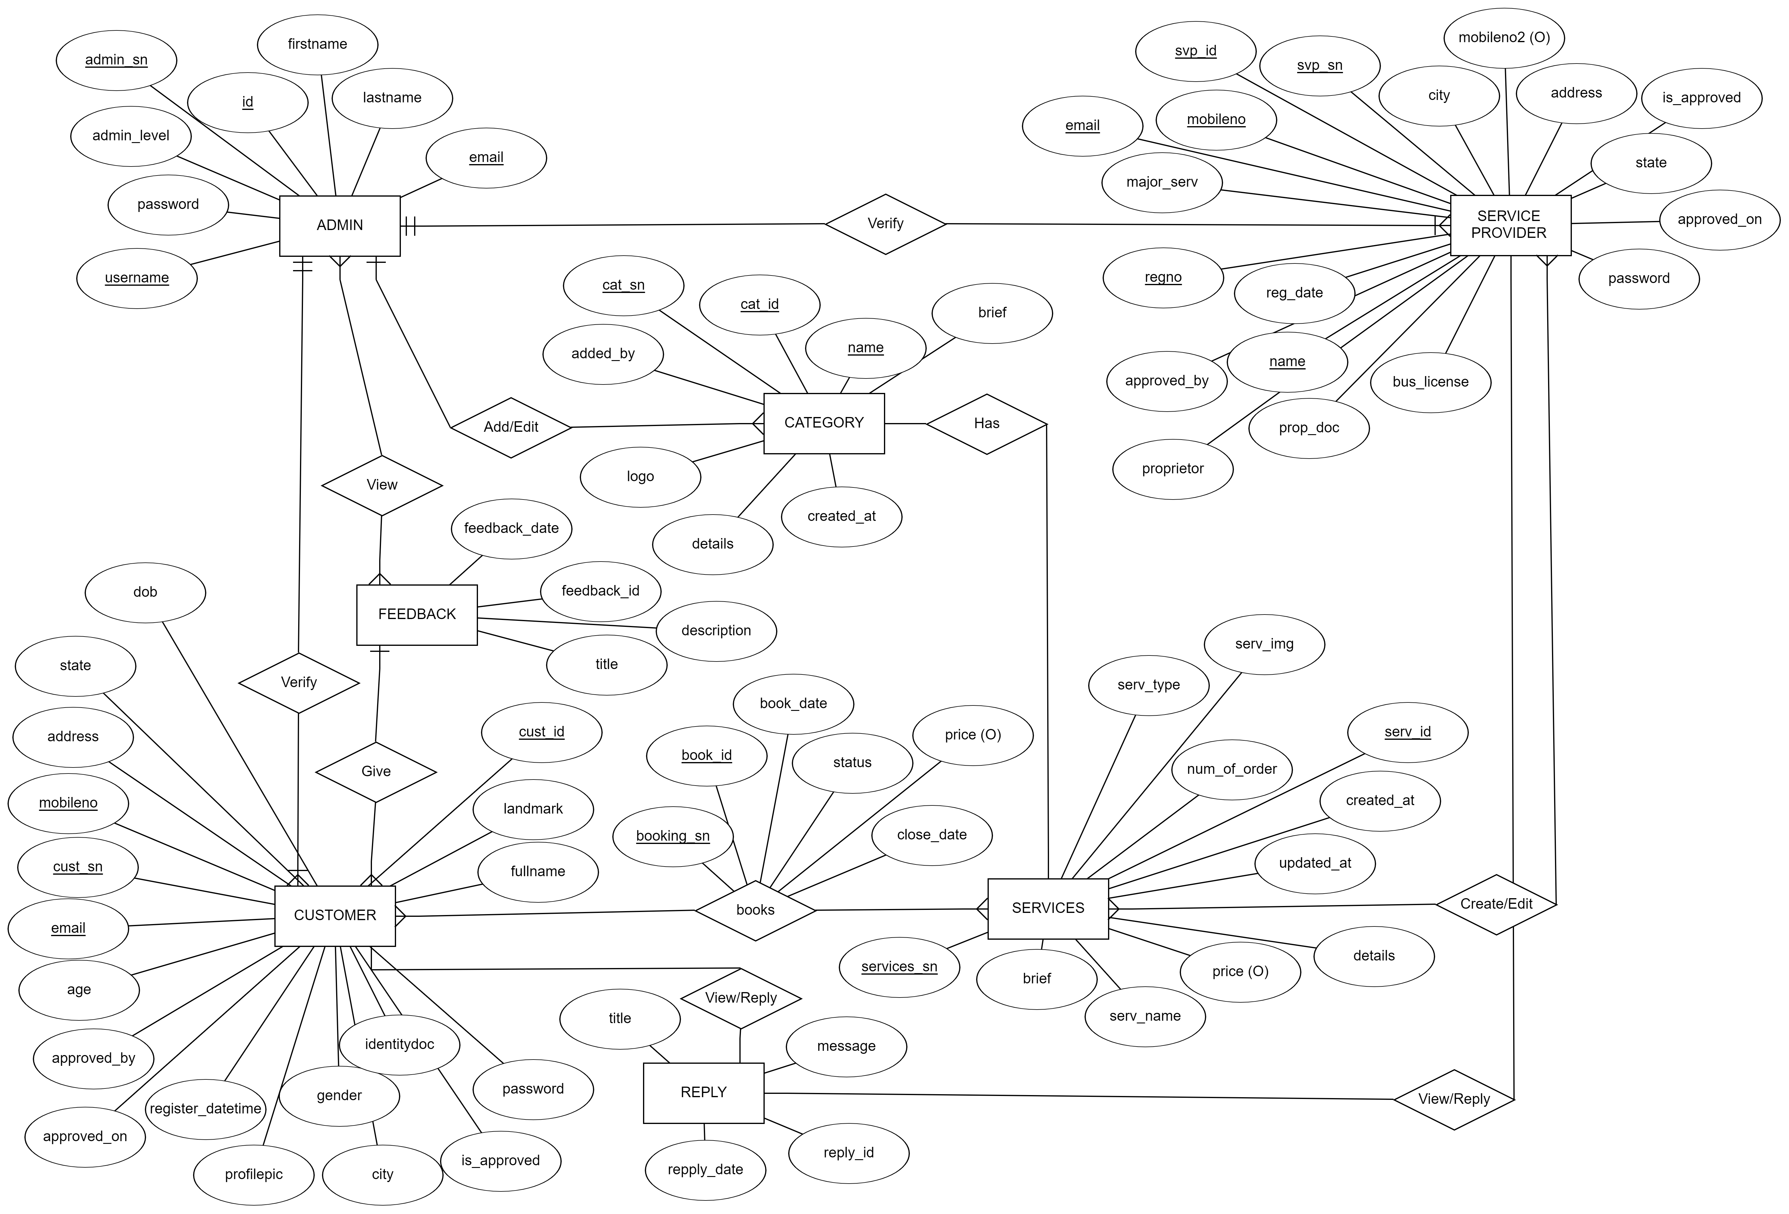
DATA MODELING (ER-diagram)

Slide 18
DATABASE SCHEMA DESIGN

Slide 19
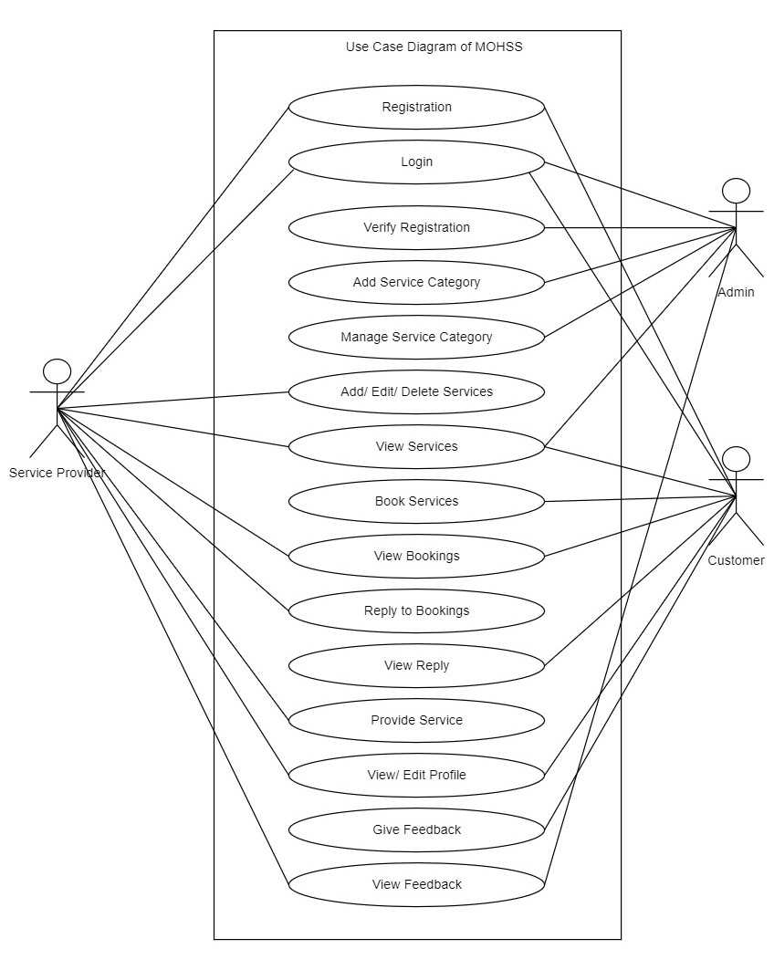
Use case diagram

Slide 20
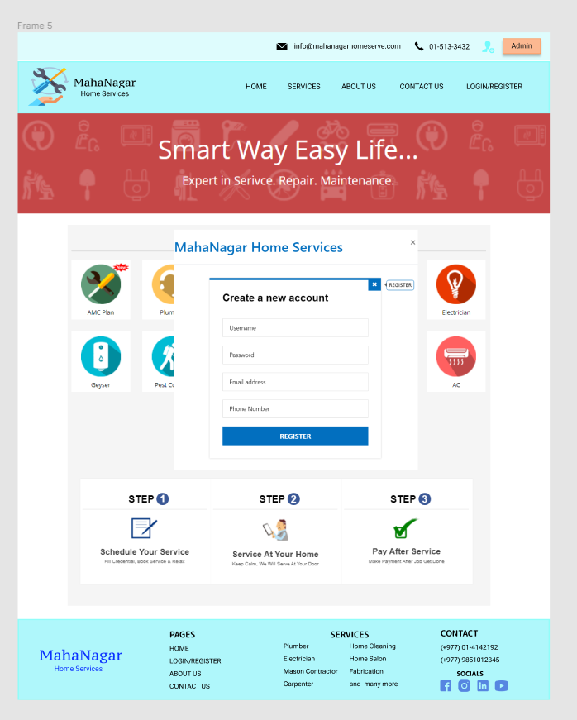
Expected outcome (ui Design)

Slide 21
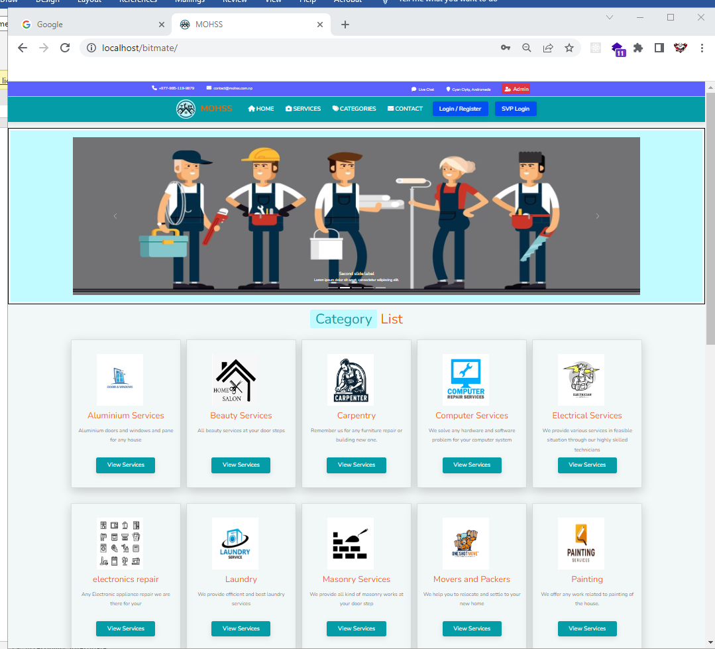
PROject screenshot

Slide 22
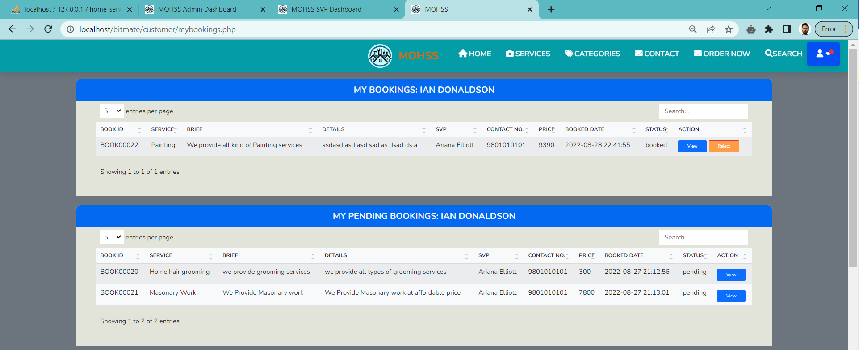
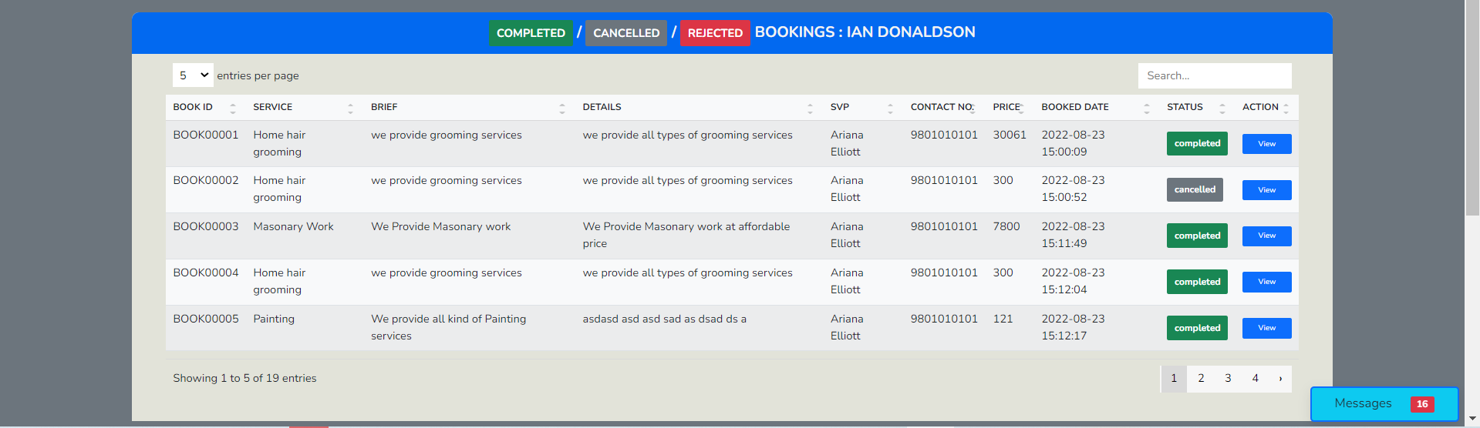
PROject screenshot

Slide 23
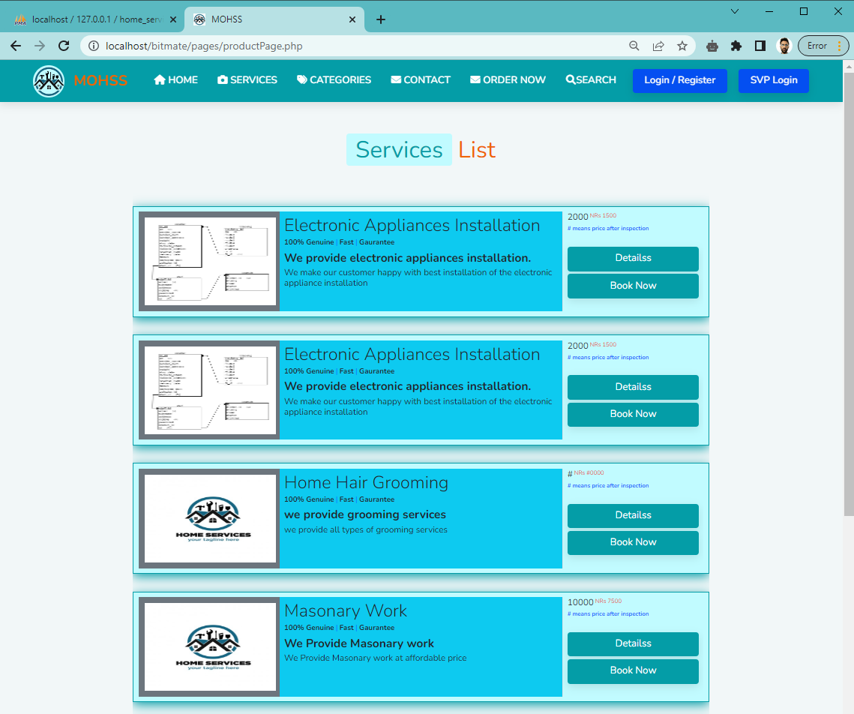
PROject screenshot

Slide 24
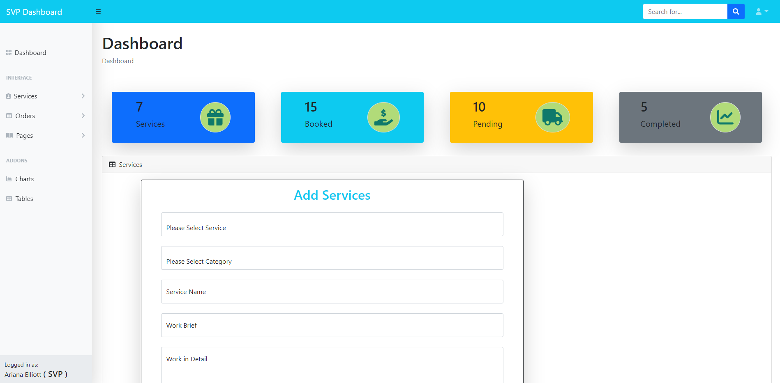
PROject screenshot

Slide 25
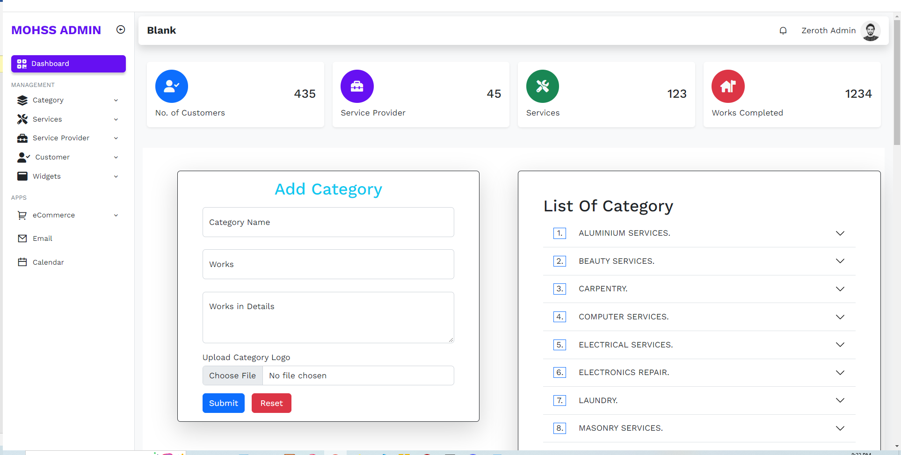
PROject screenshot

Slide 26
References
[1]: https://www.figma.com
[2]: https://www.sewahh.com
[3]: https://www.sajilosewa.com
[4]: https://www.hservices.com.ca
[5]: https://www.quicgo.com.
[6]: https://www.urbanclap.com.

Slide 27
Thank you

